Slide 1
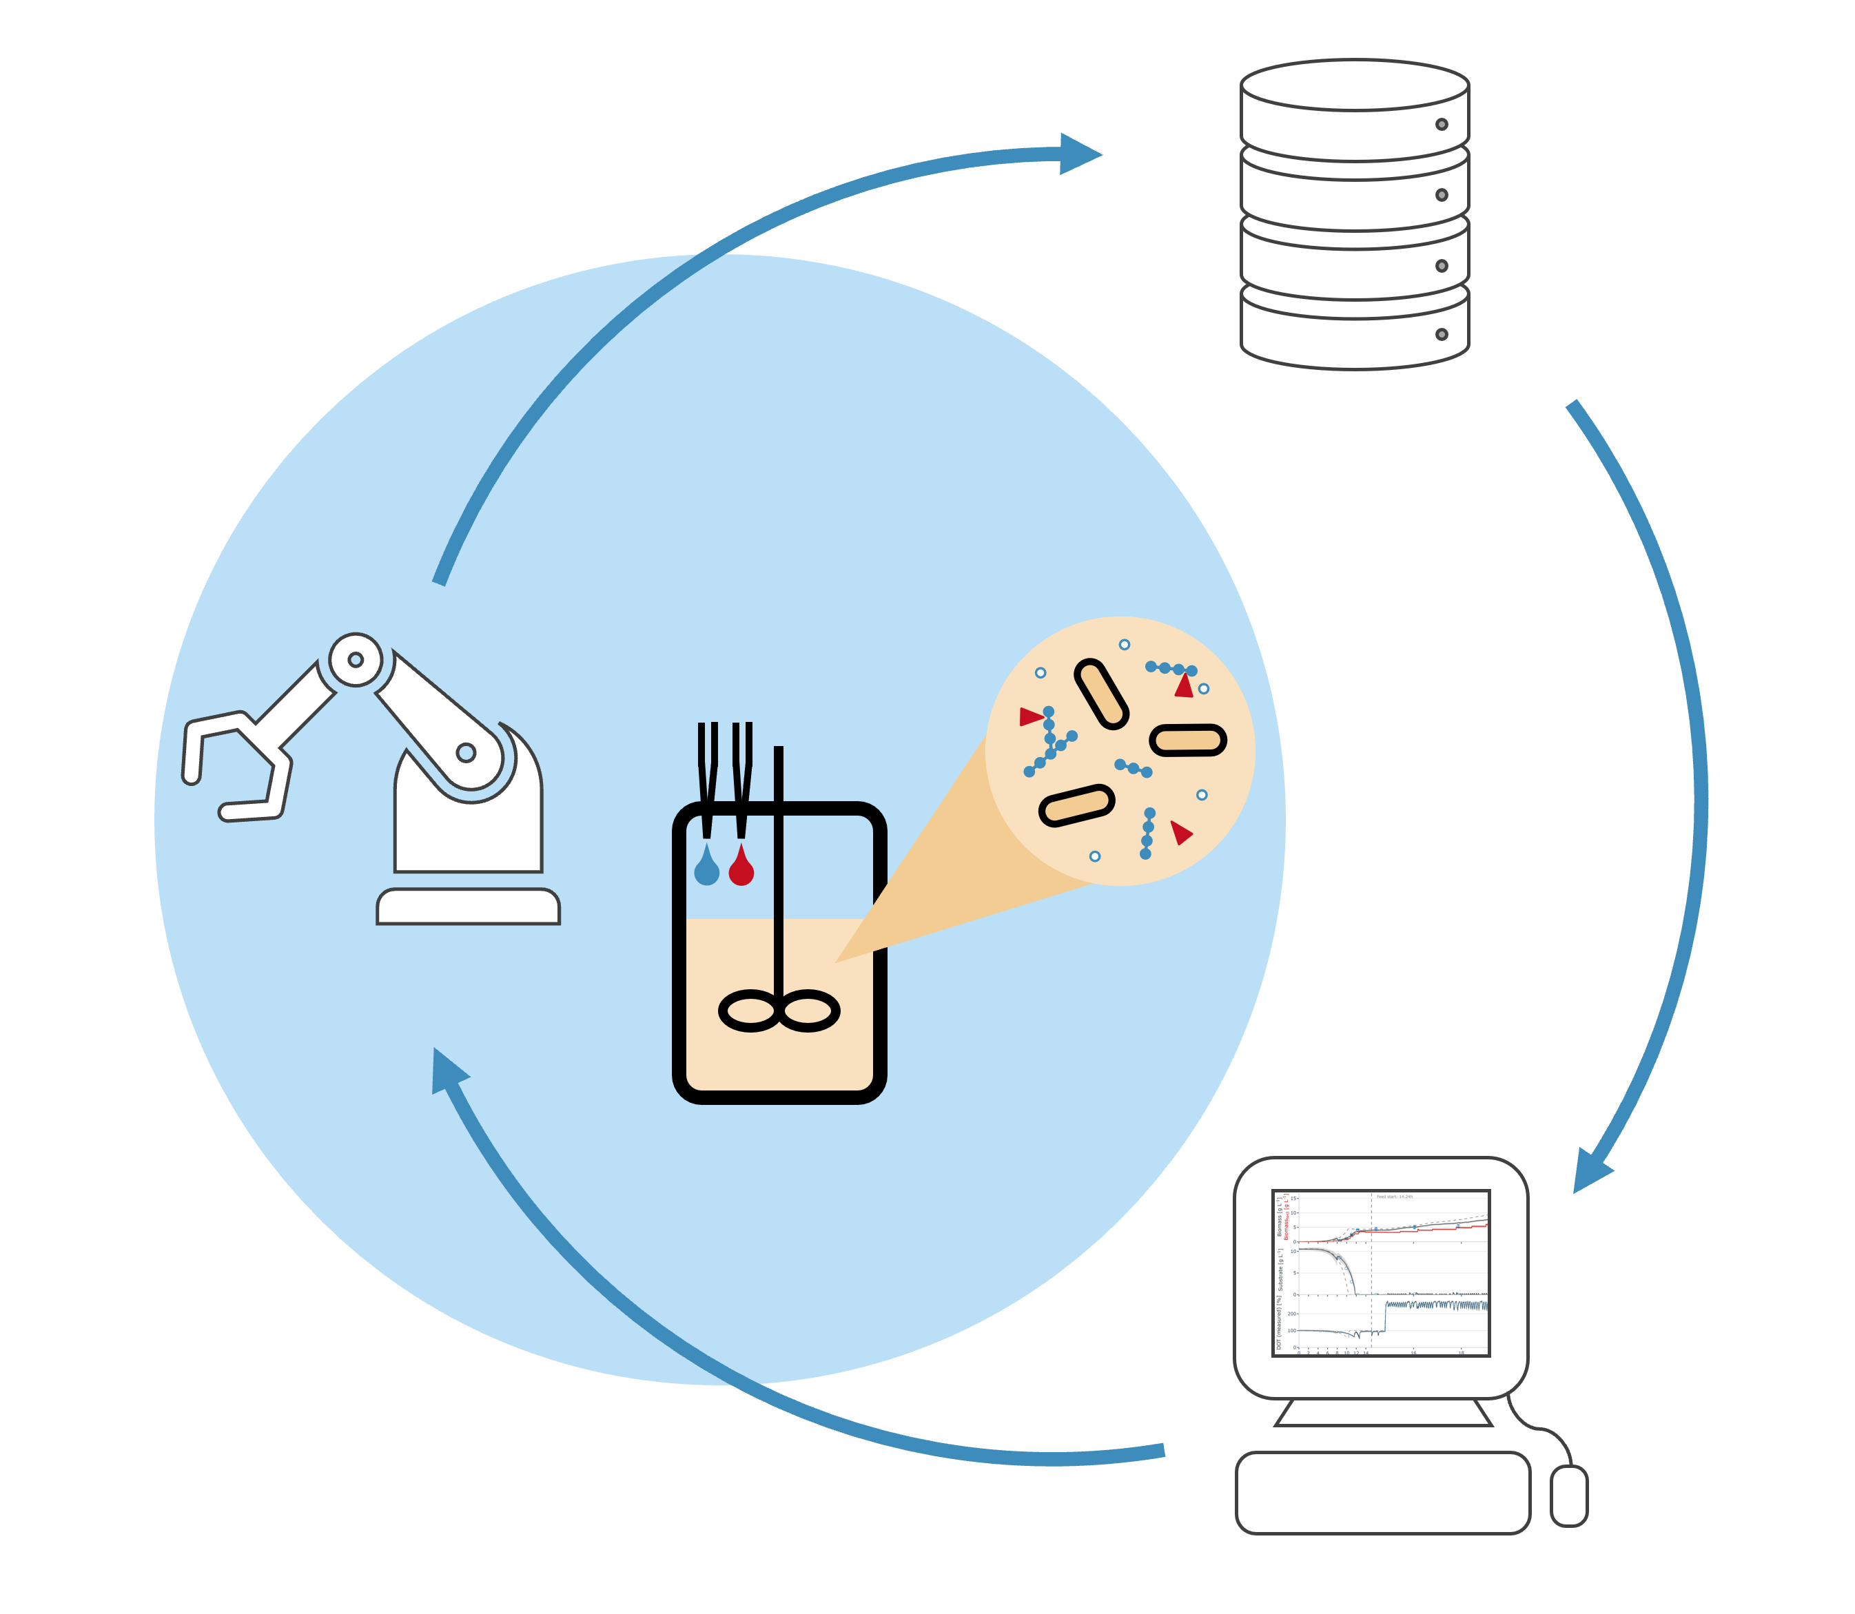
Recent doctoral theses at Bioprocess Engineering, TU Berlin
Niels Krausch (2024) Optimal operation of small-scale bioprocesses using model predictive control
Theresa Menzel (2023) Potential of gradient monitoring, bioaugmentation, and thin-slurry recirculation for microbial plug-flow hydrolysis of lignocellulosic residues
Annina Kemmer (2023) Development of advanced feeding strategies for high throughput mini-bioreactor systems
Björn Gutschmann (2022) Process development and monitoring of polyhydroxyalkanoate production from oleaginous feedstocks with Ralstonia eutropha
Qin Fan (2022) Development of a bioprocess for heterologous hydrogenase production in Escherichia coli
Maryke Fehlau (2022) Enzymatic Synthesis of Nucleoside 5’-Triphosphates
Felix Kaspar (2021) Analytical methods and thermodynamic frameworks for efficient biocatalytic nucleoside synthesis via nucleoside phosphorylases
Sebastian Hans (2021) Accelerating biological screenings through the combination of high-throughput and modeling
Robert Giessmann (2020) Prediction of kinetics and yields of nucleoside phosphorylase reactions and derived enzymatic reaction cascades
Klaus Pellicer Alborch (2020) Cocci chain length distribution as control parameter in scaling lactic acid fermentations
Ángel Córcoles García (2019) Molecular genetic approaches to decrease mis-incorporation of non-canonical branched chain amino acids into a recombinant protein in Escherichia coli
Moonsung Cho (2019) Suspension of a point-mass-loaded filament in non-uniform flows: the ballooning flight of spiders
Sarah Kamel (2019) Enzymatic synthesis of α-D-pentosefuranose-1-phosphate
Heba Yehia Mohamed (2019) Chemoenzymatic synthesis of nucleoside analogs as potential medicinal agents
Funda C. Ertem (2019) Life cycle assessment and modeling approaches as a combined evaluation tool for sustainable control strategies at biogas plants
Your name Title Title Title Title Title Title Title Title Title Title Title Title Title Title TU Berlin
Title Title Title Title Title Title Title Title Title Title Title Title Title Title
Your name - Dissertation
2024
Notes:
Endformat: B5 Format
Maße: Höhe: 29.7 cm; Breite: 21 cm
Schnittmaße im Powerpoint durch schwarze Linien angedeutet → Elemente sind größer gezogen damit beim Zuschneiden nach dem Druck noch Puffer ist
Breite Buchrücken: 9 cm
für ~150 Seiten Wordfile -> 75 Druckseiten (Vorder und Rückseite)
bei Bedarf anpassen oder im Copyshop anpassen lassen

